Slide 1

AgriCenter
The Farmer Family…..

Slide 2

DEVELOPED BY :
Yash B Patel. (MCA-3,21MCA107)
Dhruv K Patel(MCA-3,21MCA075)
Guided by : Dr. Sagar Kavaiva
Submitted to
Smt. Chandaben Mohanbhai Patel Institute of Computer Applications
CHARUSAT
Changa
Smt k.b.shah(vadi vihar) science college

Slide 3
ABSTRACT
This is project of online shopping, as the time goes we are used to purchase many products online now a days this became a craze for youth.
Here we have four products for selling first is seeds, second is Pesticides, third is Fertilizer and fourth is machinery we have a lots of designs and categories for all product.
User can easily see all the variety, if user wants to connect with us or they wants to buy any product they will have to register on our site.

Slide 4
PROJECT DEFINITION
It is a small web app. This modules provide information about Agriculture related product as per category like seeds, pesticides, fertilizer and machinery.
This portal provides facility of admin module and client module.

Slide 5
HARDWARE & SOFTWARE REQUIREMENT
Hardware:
Component | specification
processor | INTEL PENTIUM 4
RAM | 512MB
Hard Disk | 80GB
Software:
Component | specification
Front End: | HTML, HTML5, CSS, JAVA SCRIPT,PHP
Back End: | MySql
Documentation Tool : | MICROSOFT WORD 2010

Slide 6
MODULE
Admin
Registration / Log-In
Add Admin
Add Company
Add Category
Add Subcategory
Add Product
Manage Items
View Registered User
View Orders
View Feedback
View FAQ
Log-Out
Client
Registration / Log-In
View Item
Add To Cart
Purchase Items
View Receipt
Give Feedback
Give FAQ
Log-Out

Slide 7
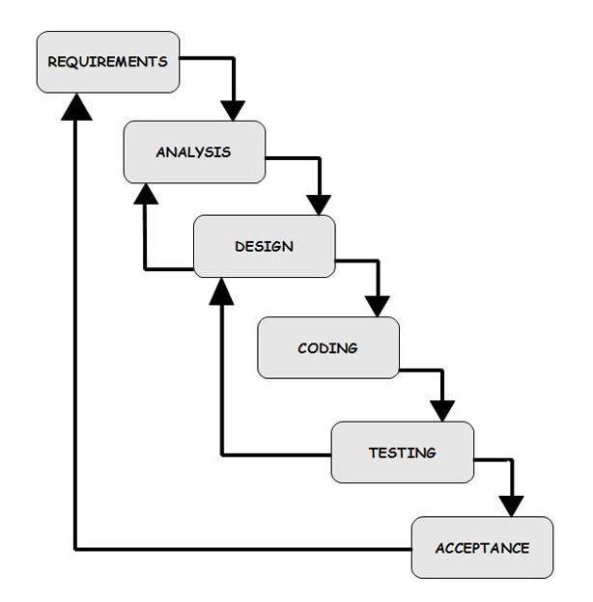
MODEL
iterative Model

Slide 8
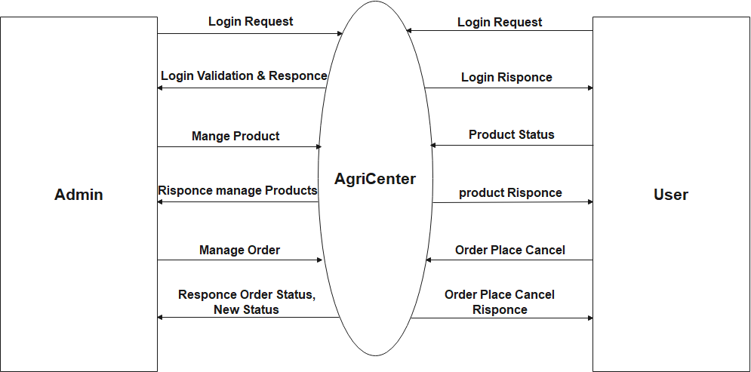
DIAGRAMS
Context Diagram(0-Level):

Slide 9
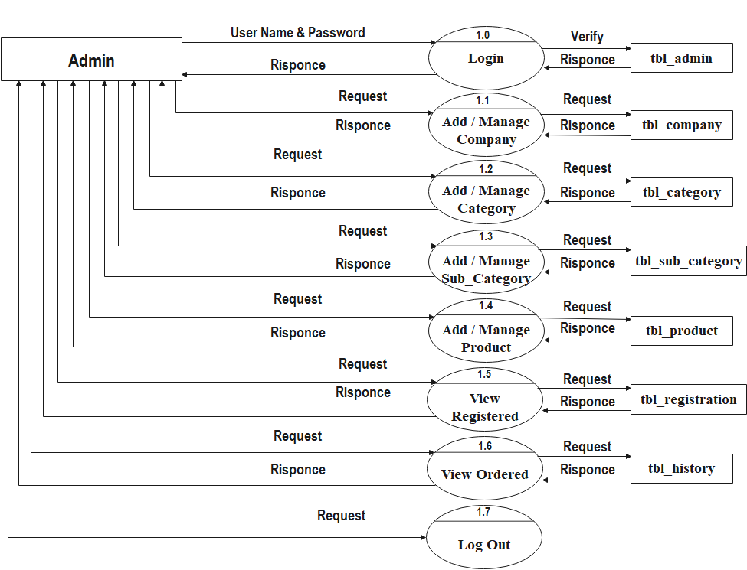
DFD(1-Level) (Admin Side):

Slide 10
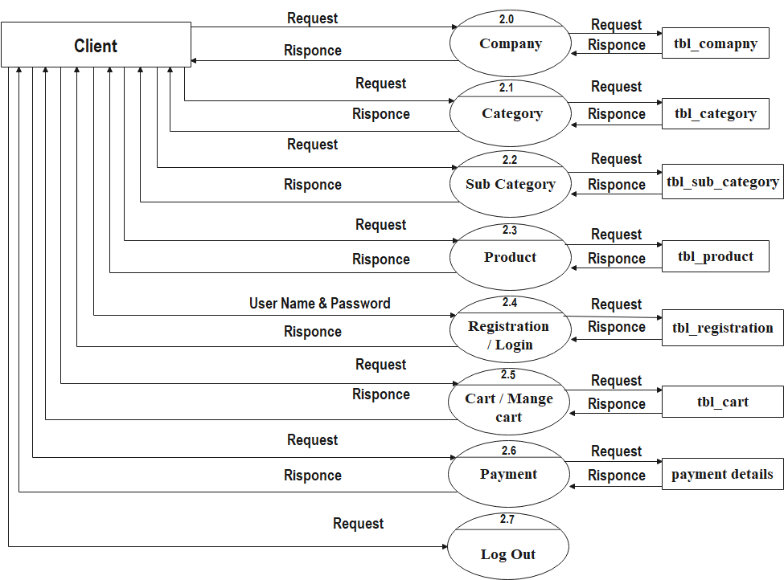
DFD(1-Level) (User Side):

Slide 11
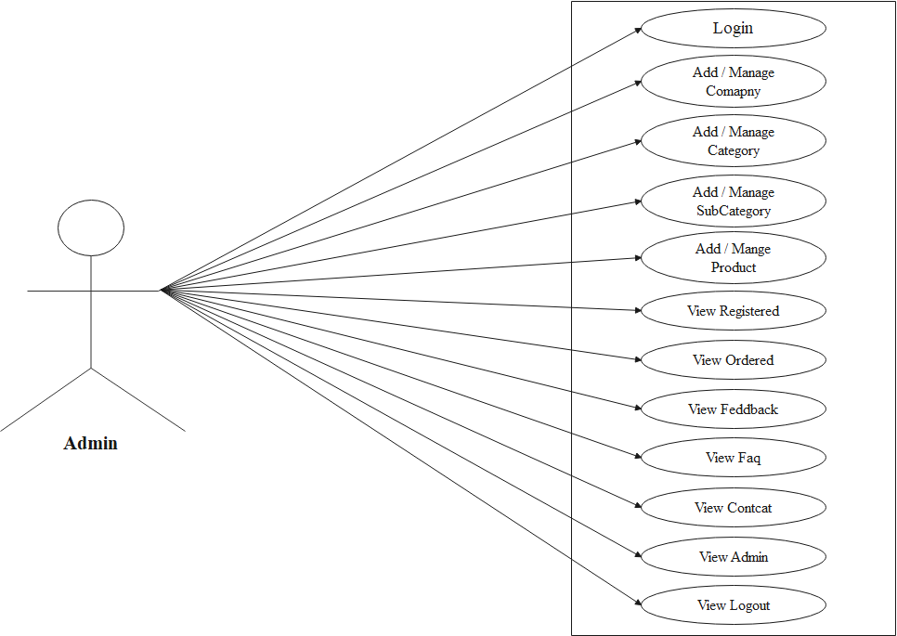
Use case diagram :
(Admin Side)

Slide 12
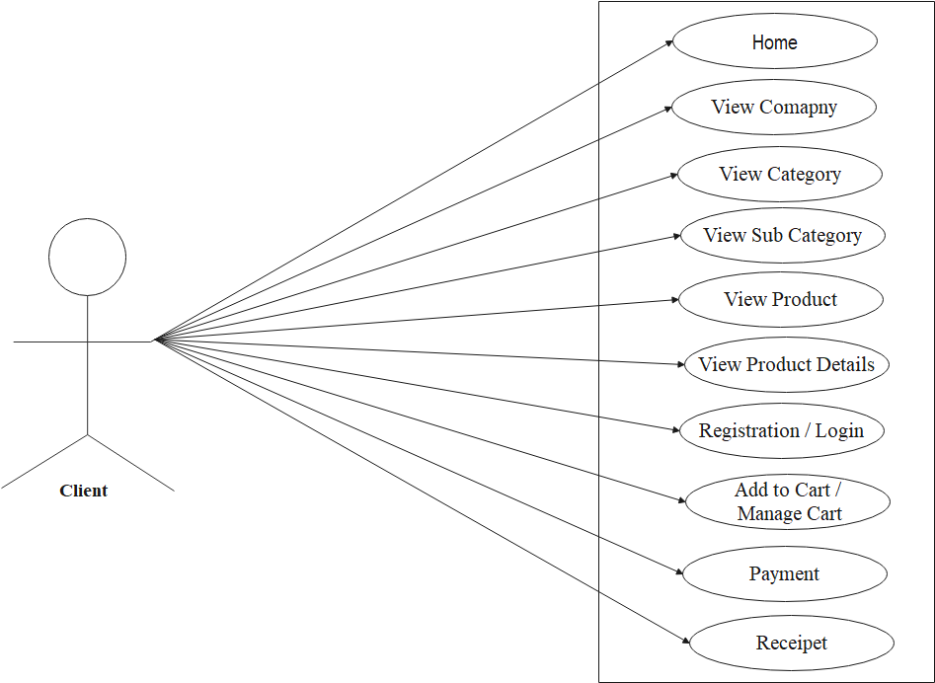
Use case diagram :
(User Side)

Slide 13
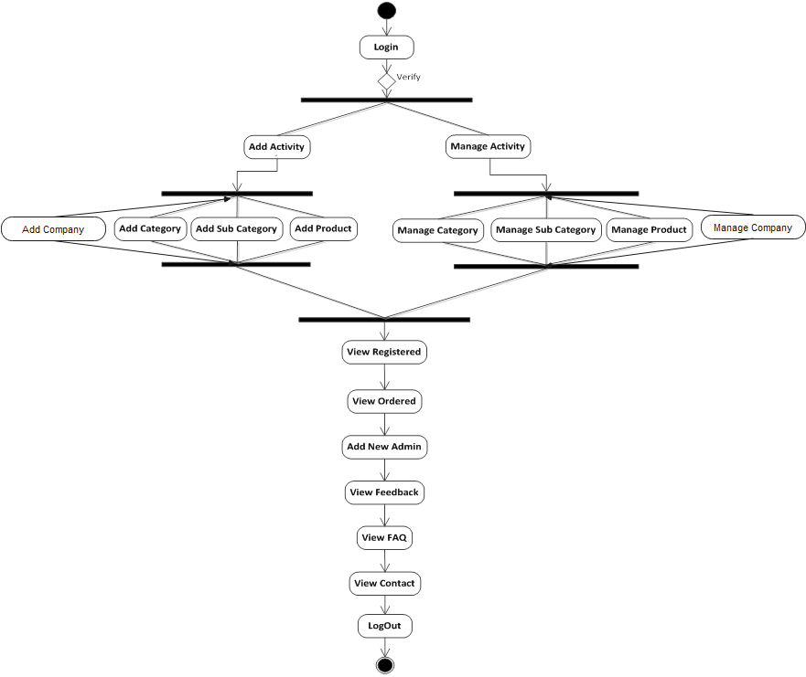
Activity Diagram:
(Admin)

Slide 14
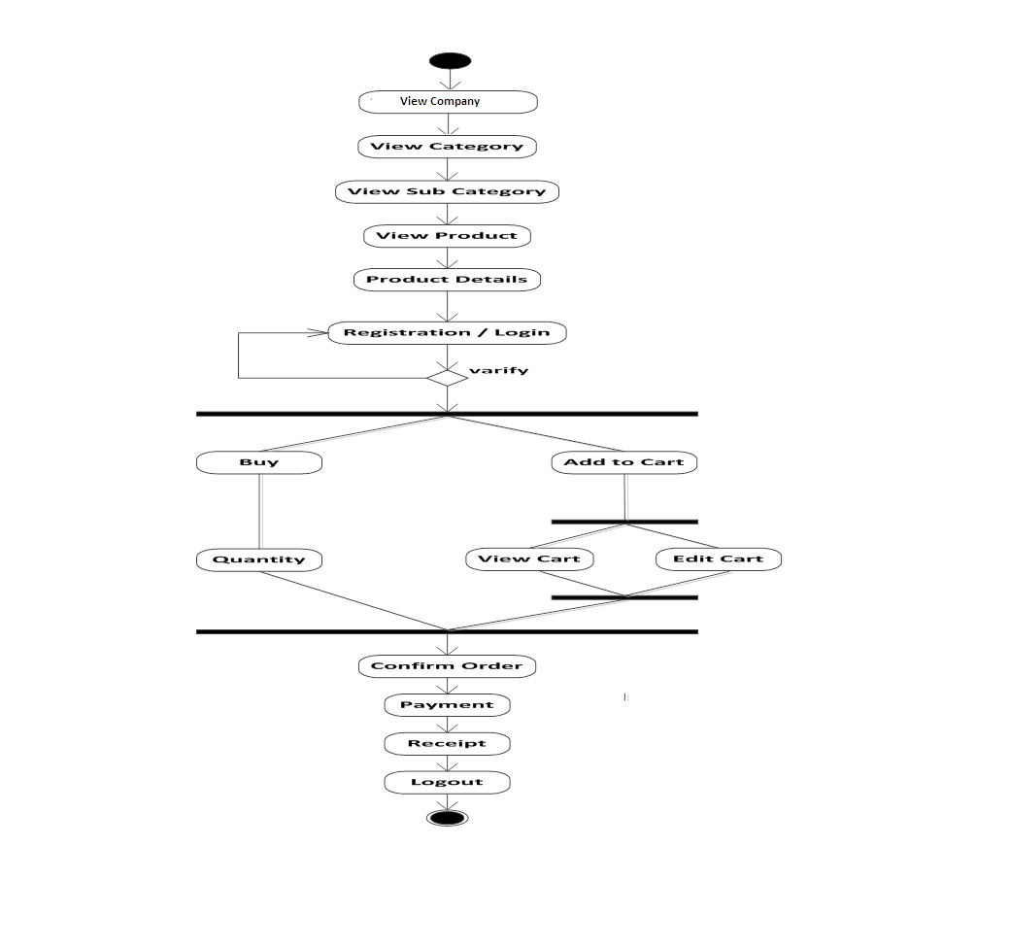
Activity Diagram:
(Client)

Slide 15
DATA DICTIONARY
tbl_admin:
Field | Type | Constraint | Description
a_id | Int(5) | Primary key | Autoincrement | Admin id
u_name | varchar(50) | Not Null | Admin name
email | varchar(30) | Not Null | Admin email
password | varchar(30) | Not Null | Admin password
question1 | varchar(100) | Not Null | Question1
answer1 | varchar(100) | Not Null | answer1
question2 | varchar(100) | Not Null | Question2
answer2 | varchar(100) | Not Null | Answer2
a_image | varchar(100) | Not Null | Admin image

Slide 16
tbl_category:
Field | Type | Constraint | Description
cat_id | int(5) | Primary key | Autoincrement | Category's Unique Id
cat_name | varchar(100) | Not Null | Category Name
cat_image | varchar(100) | Not Null | Category Picture Path

Slide 17
tbl_sub_category:
Field | Type | Constrains | Description
sub_cat_id | int(5) | Primary Key | Autoincrement | Sub Category Id
cat_id | int(5) | Foreign key | Category Id
sub_cat_name | varchar(100) | Not Null | Sub Category Name
sub_cat_image | varchar(100) | Not Null | Sub Category Image

Slide 18
tbl_company:
Field | Type | Constrains | Description
c_id | int(5) | Primary key | Autoincrement | Company Id
c_name | varchar(100) | Not Null | Company Name
c_logo | varchar(100) | Not Null | Company Logo

Slide 19
tbl_product:
Field | Type | Constrains | Description
p_id | int(5) | Primary Key | Autoincrement | Product Id
cat_id | int(5) | foreign key | Category Id
c_id | int(5) | foreign key | Company Id
sub_cat_id | int(5) | foreign key | Sub Category Id
p_name | varchar(100) | Not Null | Product Name
p_old_price | int(5) | Not Null | Product old price
p_new_price | int(5) | Not Null | Product new price
p_image1 | varchar(100) | Not Null | Product image1
p_image2 | varchar(100) | Not Null | Product image2
p_color | varchar(100) | Not Null | Product color
p_weight | varchar(100) | Not Null | Product weight
p_dose | varchar(100) | Not Null | Product dose
p_process | varchar(500) | Not Null | Product process
p_feature | varchar(200) | Not Null | Product feature
p_material | varchar(200) | Not Null | Product material
p_description | varchar(500) | Not Null | Product description
p_stock | int(5) | Not Null | Product stock
p_date | varchar(20) | Not Null | Product date

Slide 20
tbl_registration:
Field | Type | Constrains | Description
r_id | int(5) | Primary key | Autoincrement | Registration id
f_name | varchar(50) | Not Null | First name
m_name | varchar(50) | Not Null | Middle name
l_name | varchar(50) | Not Null | Last Name
gender | varchar(6) | Not Null | Register gender
email | varchar(30) | Not Null | Email
contact | int(10) | Not Null | Register contact
address | varchar(100) | Not Null | Register address
pincode | int(6) | Not Null | Register pincode
city | varchar(50) | Not Null | Register city
state | varchar(20) | Not Null | Register state
country | varchar(20) | Not Null | Register country
u_name | varchar(30) | Not Null | Register user name
password | varchar(30) | Not Null | Register password

Slide 21
tbl_cart
Field | Type | Constrains | Description
cart_id | int(5) | Primary key | Autoincrement | Cart id
p_id | int(5) | Foreign key | Product id
r_id | int(5) | Foreign key | Registration id
quantity | int(5) | Not Null | Cart quantity
total_price | int(5) | Not Null | Product Total Price
status | varchar(20) | Not Null | Product status
date | varchar(20) | Not Null | Date

Slide 22
tbl_contact:
Field | Type | Constrains | Description
con_id | int(5) | Primary key | Autoincrement | Contact id
name | varchar(50) | Not Null | Contact name
email | varchar(30) | Not Null | Contact email
subject | varchar(100) | Not null | Contact subject
message | varchar(100) | Not null | Contact message

Slide 23
tbl_faq:
Field | Type | Constrains | Description
f_id | int(5) | Primary key | Autoincrement | Faq id
u_name | varchar(100) | Not null | Faq name
email | varchar(30) | Not null | Faq email
contact | int(10) | Not Null | Faq contact
question | varchar(100) | Not null | Faq question
description | varchar(200) | Not null | Faq description
answer | varchar(200) | Not null | Faq answer
date | varchar(20) | Not null | Faq date

Slide 24
tbl_feedback:
Field | Type | Constrains | Description
f_id | int(5) | Primary key | Autoincrement | Feedback id
name | varchar(100) | Not null | Feedback name
email | varchar(30) | Not null | Feedback email
title | varchar(100) | Not null | Feedback title
description | varchar(100) | Not null | Feedback description
date | varchar(20) | Not null | Feedback date

Slide 25
tbl_comment:
Field | Type | Constrains | Description
c_id | int(5) | Primary key | Autoincrement | Comment id
p_id | int(5) | Foreign key | Product id
r_id | int(5) | Foreign key | Registration id
title | varchar(100) | Not Null | Comment title
comment | varchar(100) | Not Null | Comment
date | varchar(20) | Not Null | Comment date

Slide 26
tbl_history:
Field | Type | Constrains | Description
h_id | int(5) | Primary key | Autoincrement | History id
p_id | int(5) | Not Null | Product id
r_id | int(5) | Not Null | Registration id
quantity | int(5) | Not Null | History quantity
date | varchar(20) | Not Null | Date

Slide 27
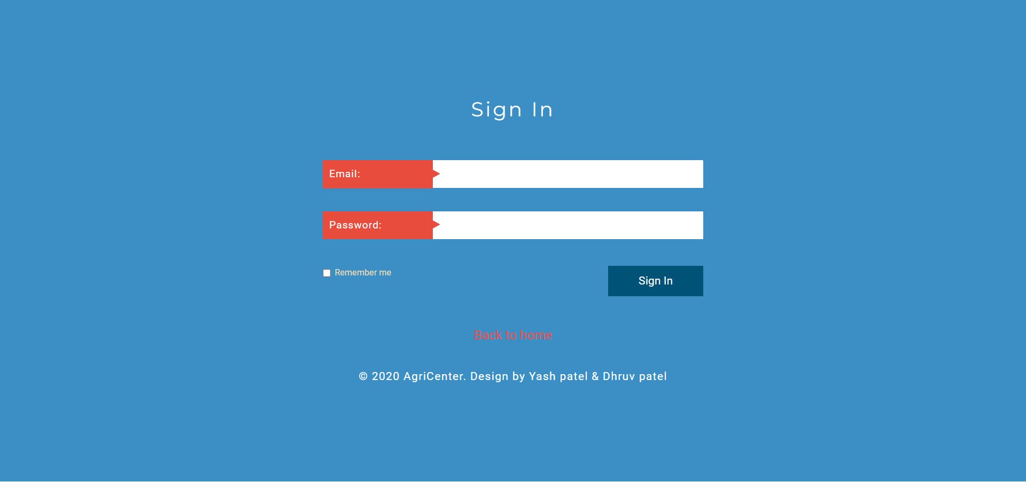
SCRENSHOTS
Admin Side:
Login Page:

Slide 28
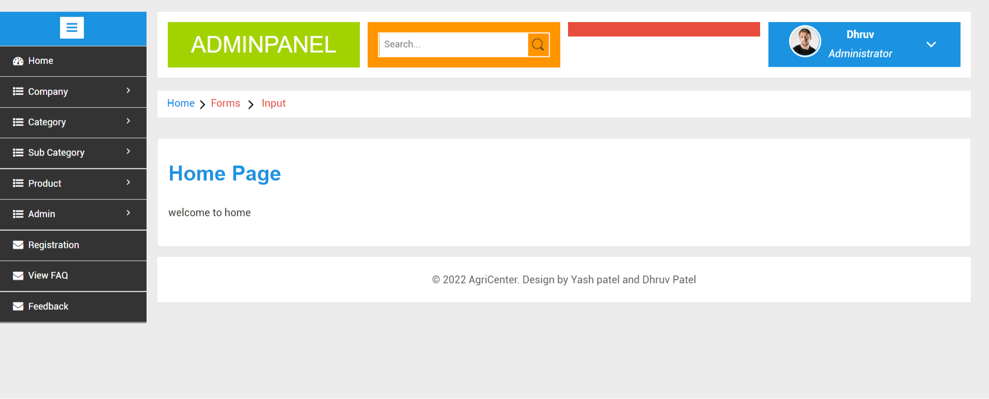
Home Page

Slide 29
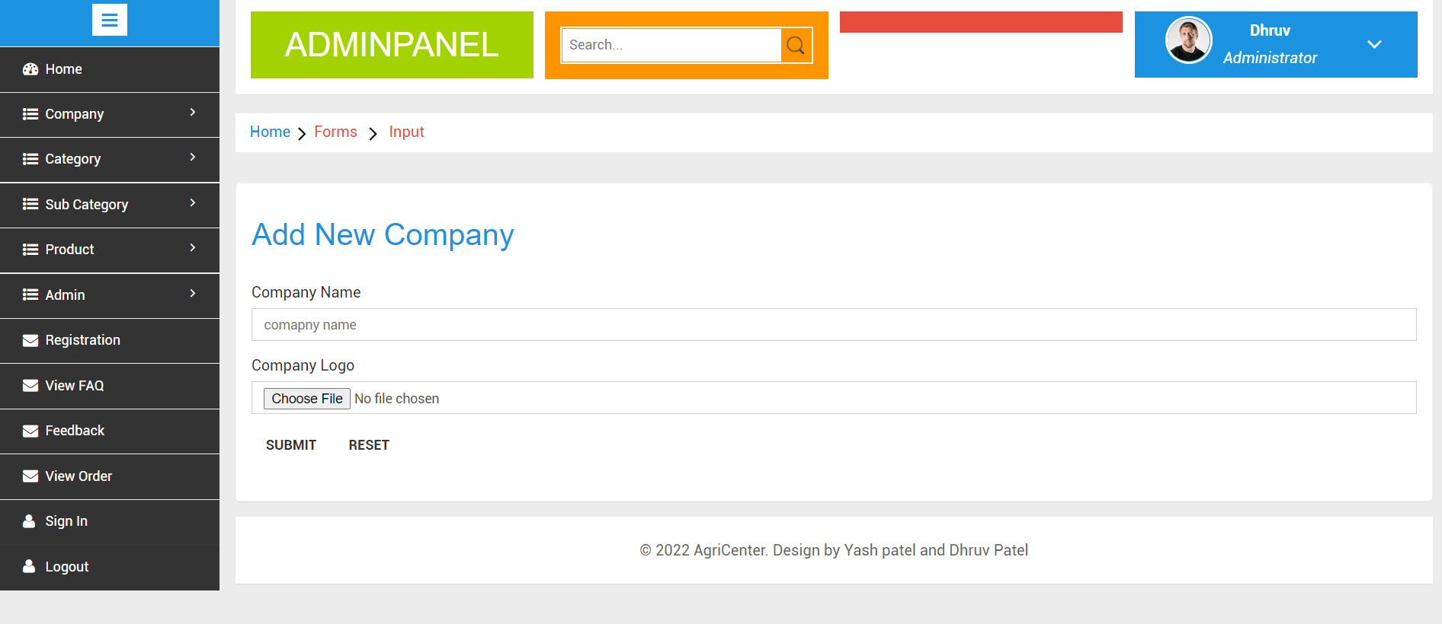
Add Company

Slide 30
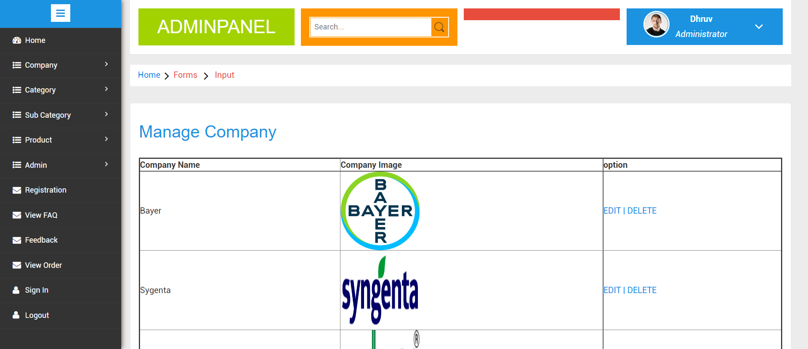
Manage company

Slide 31
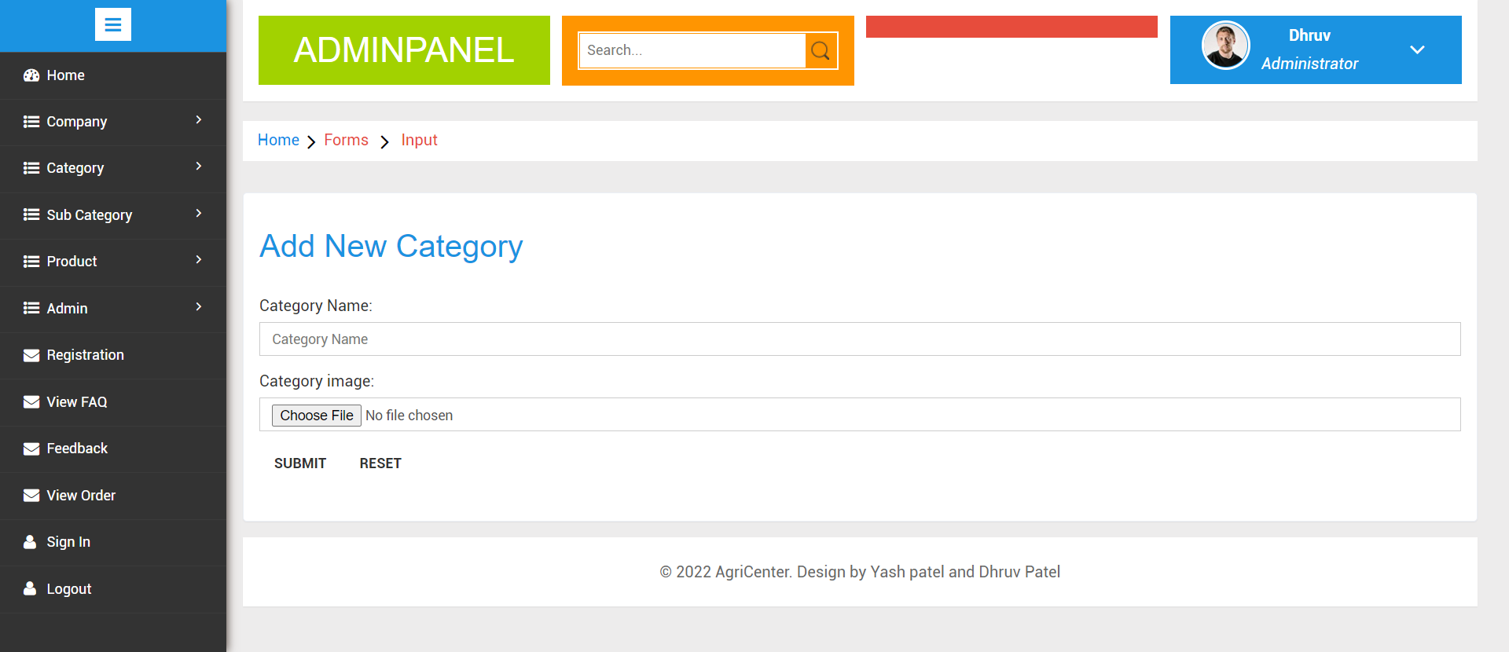
Add category

Slide 32
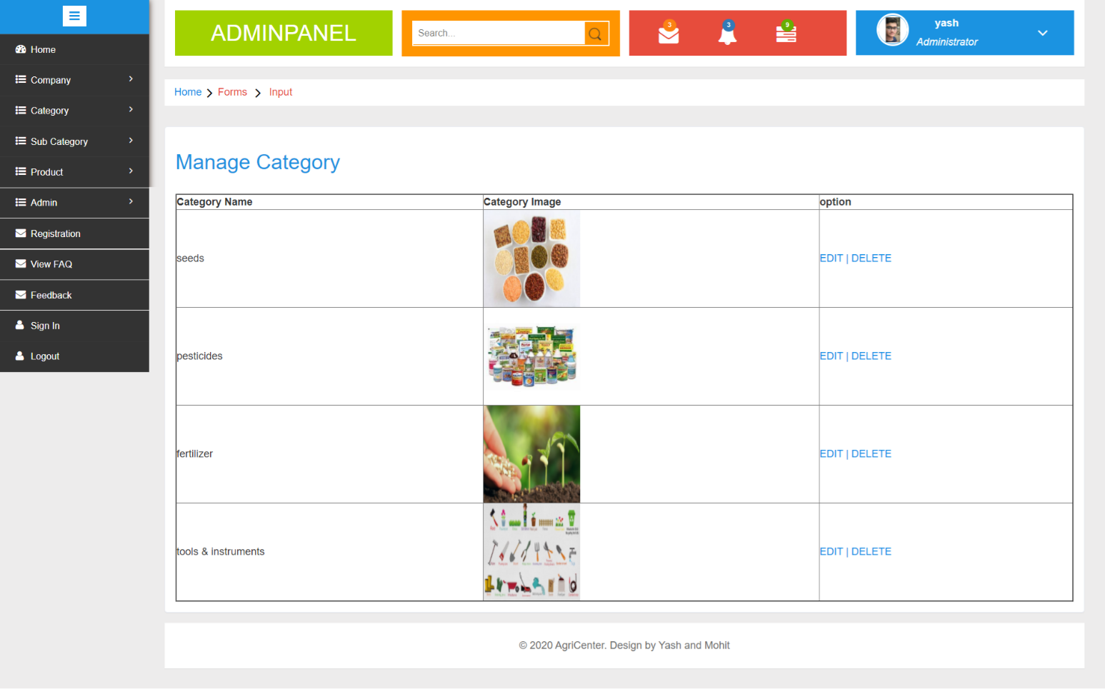
Manage Category

Slide 33
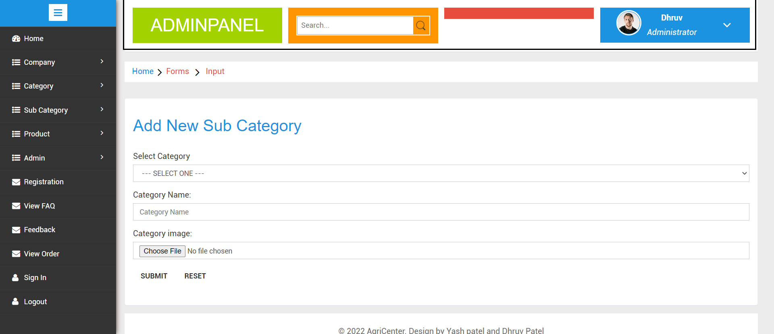
Add Sub Category

Slide 34
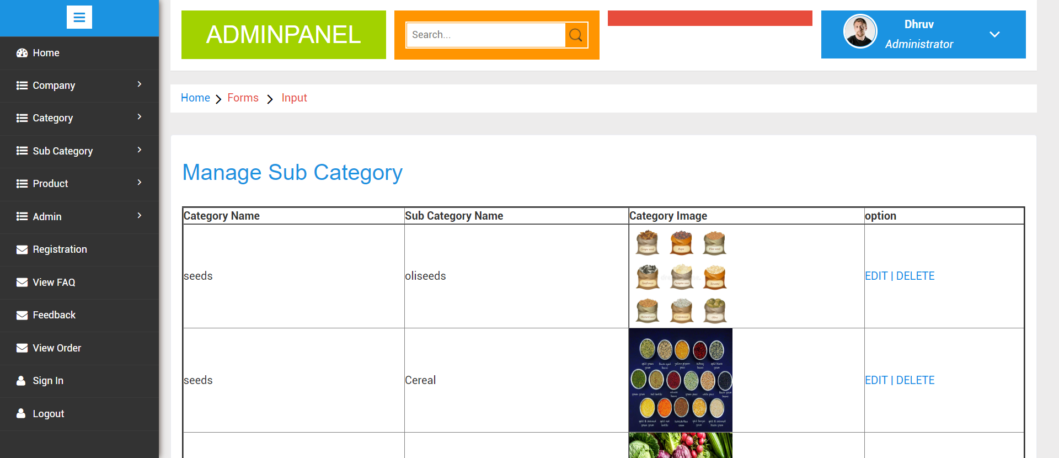
Manage Sub Category

Slide 35
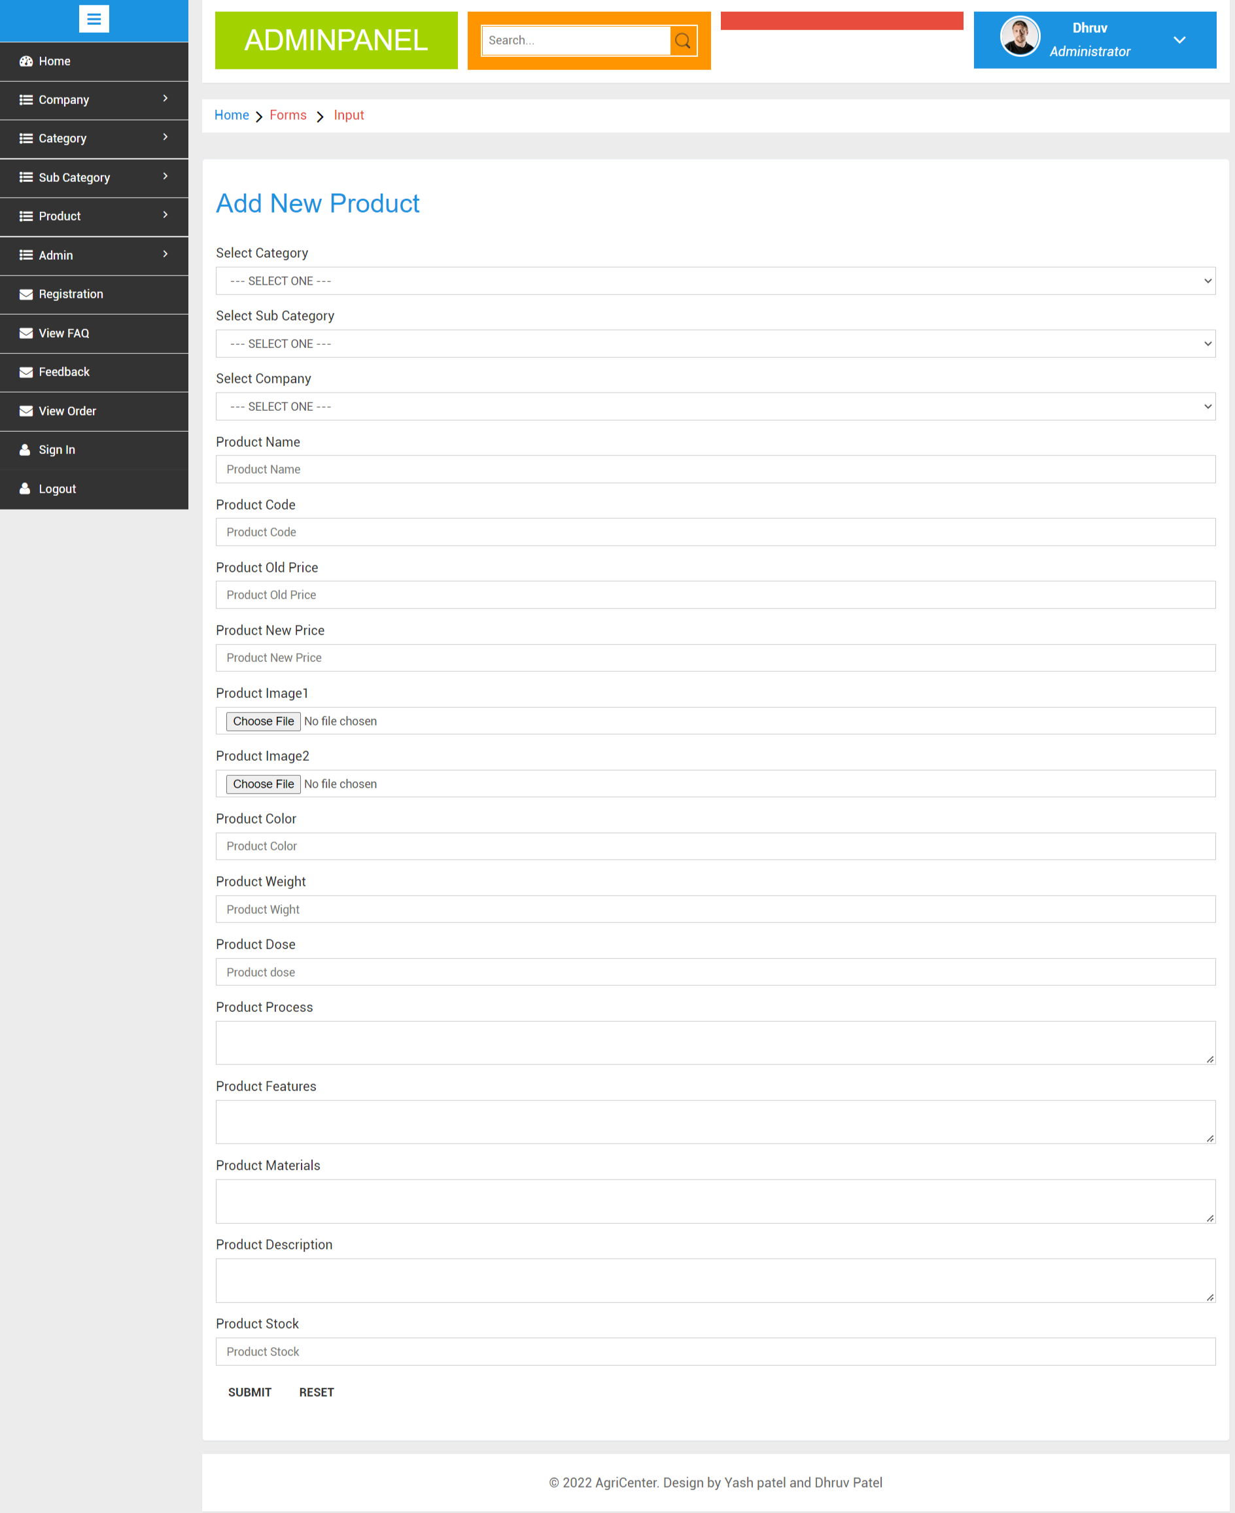
Add Product

Slide 36
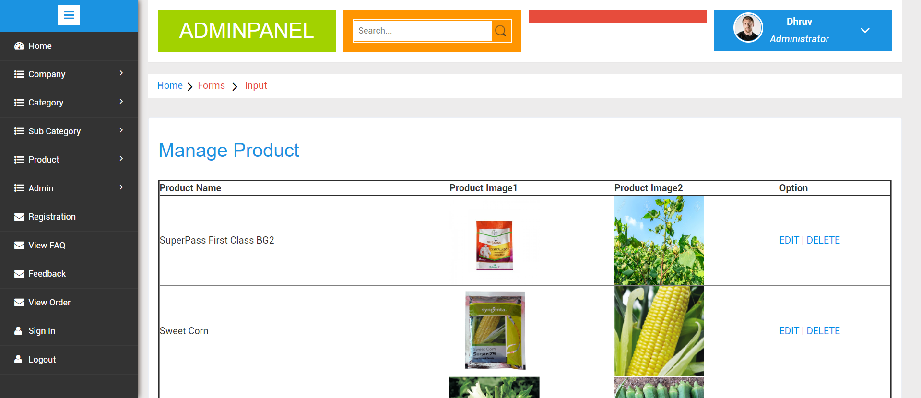
Manage Product

Slide 37
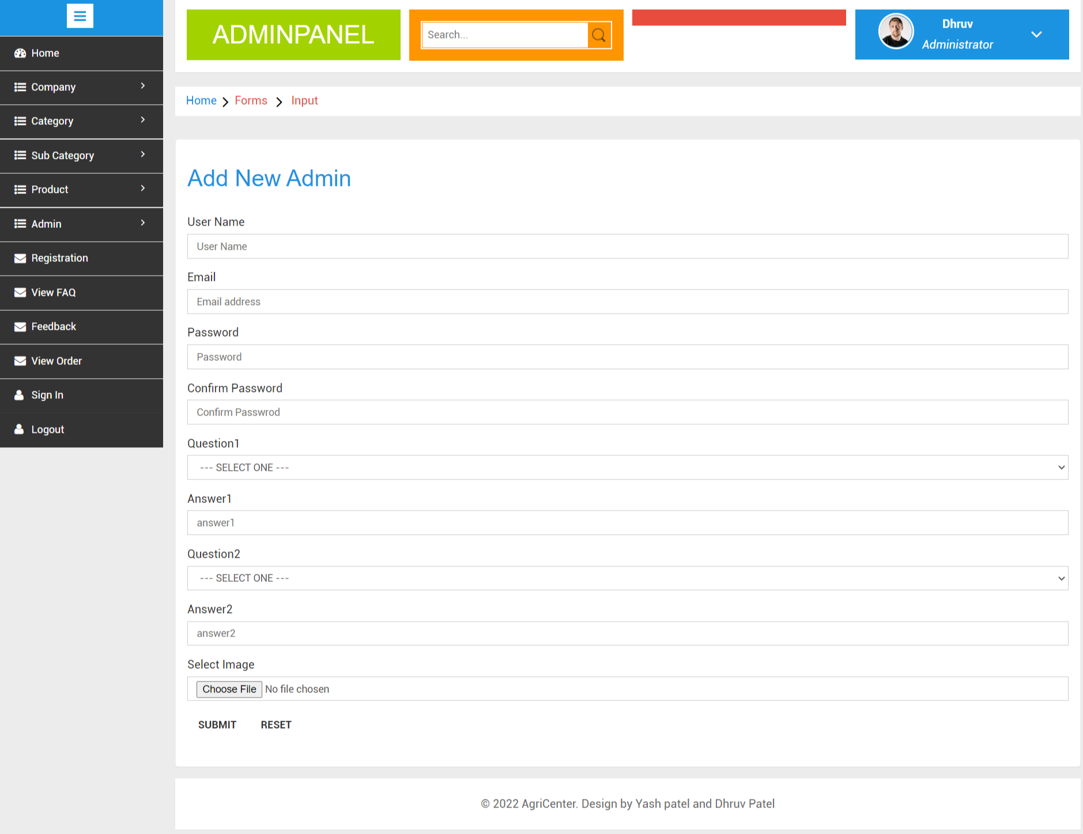
Add Admin

Slide 38
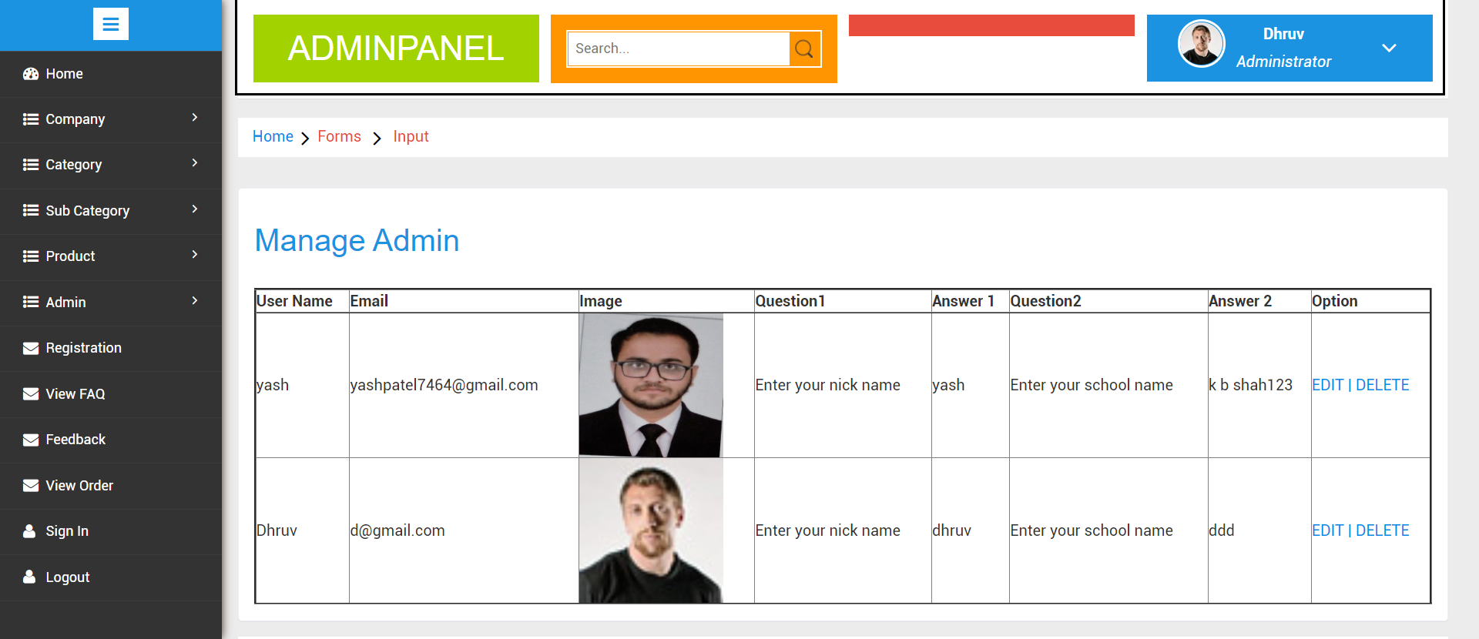
Manage Admin

Slide 39
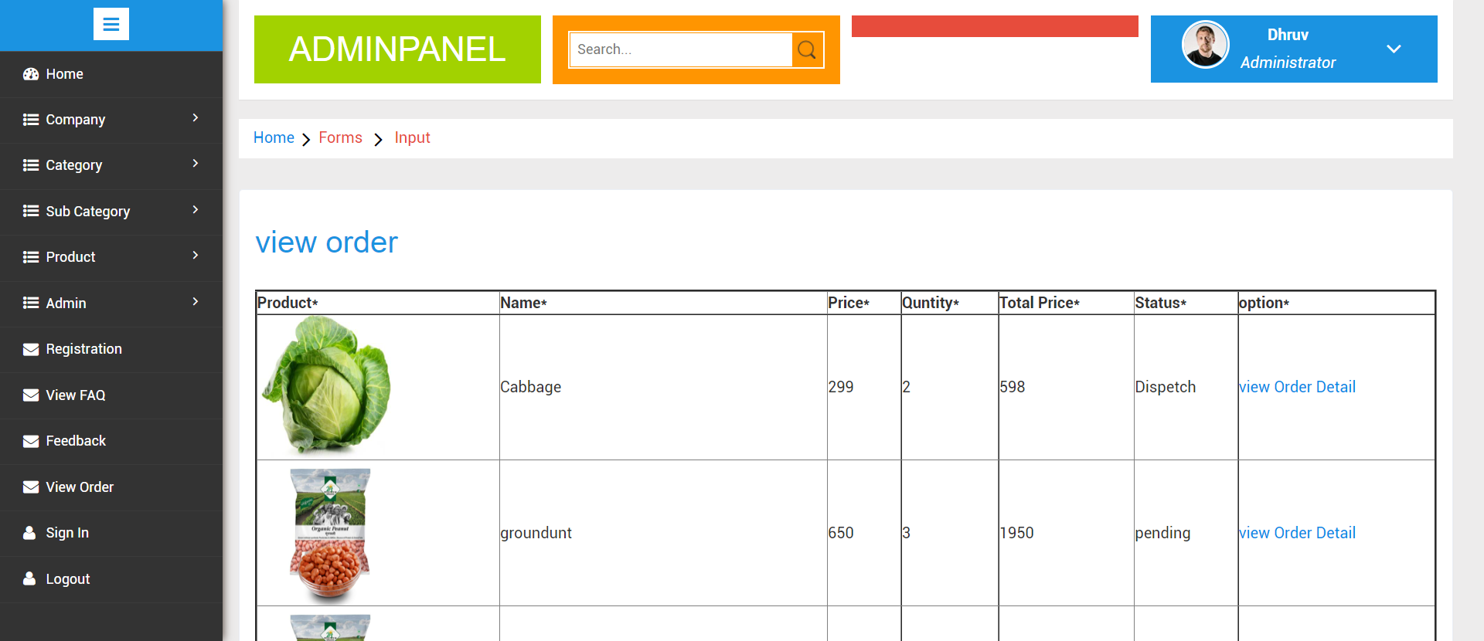
View Order

Slide 40
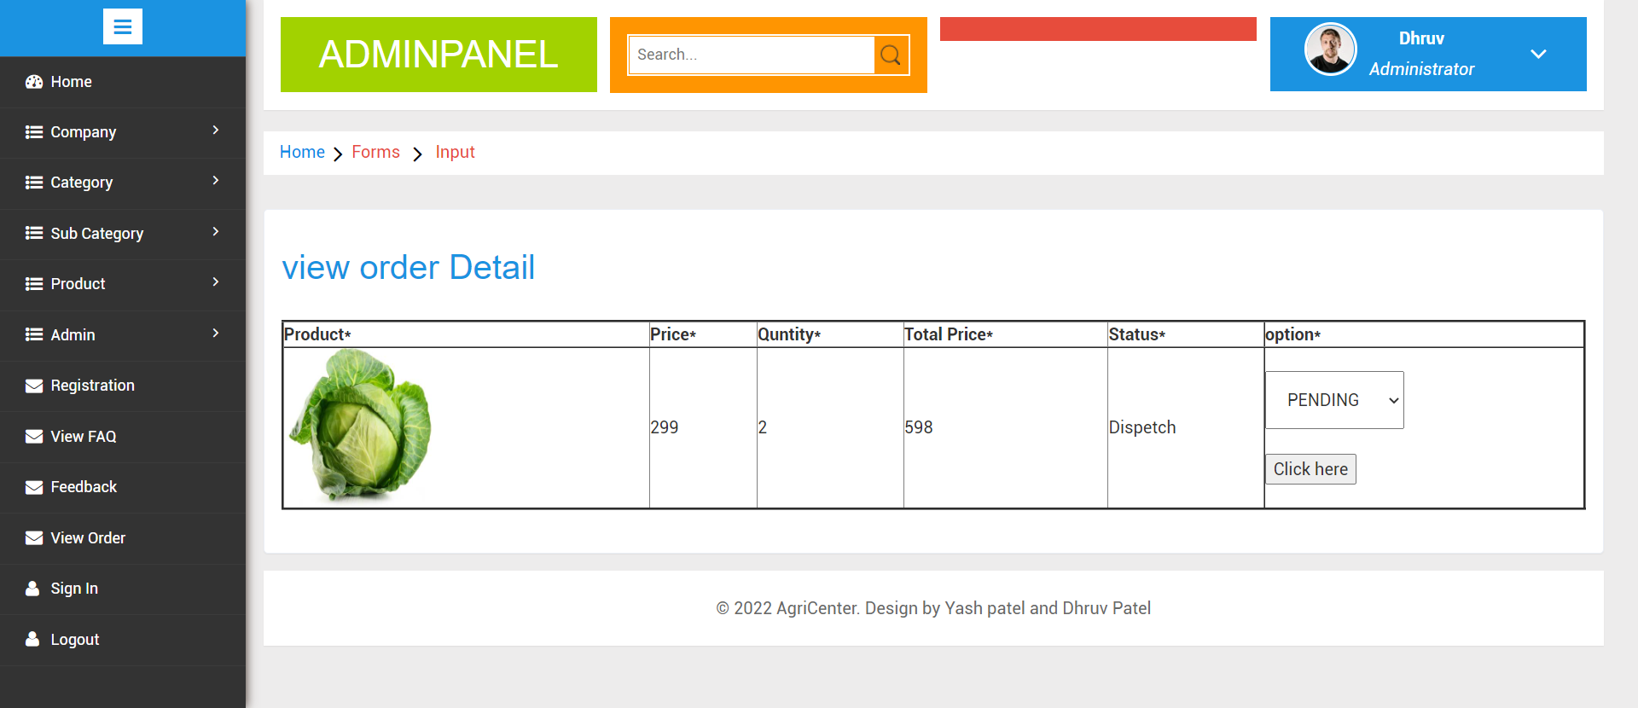
View Order Detail

Slide 41
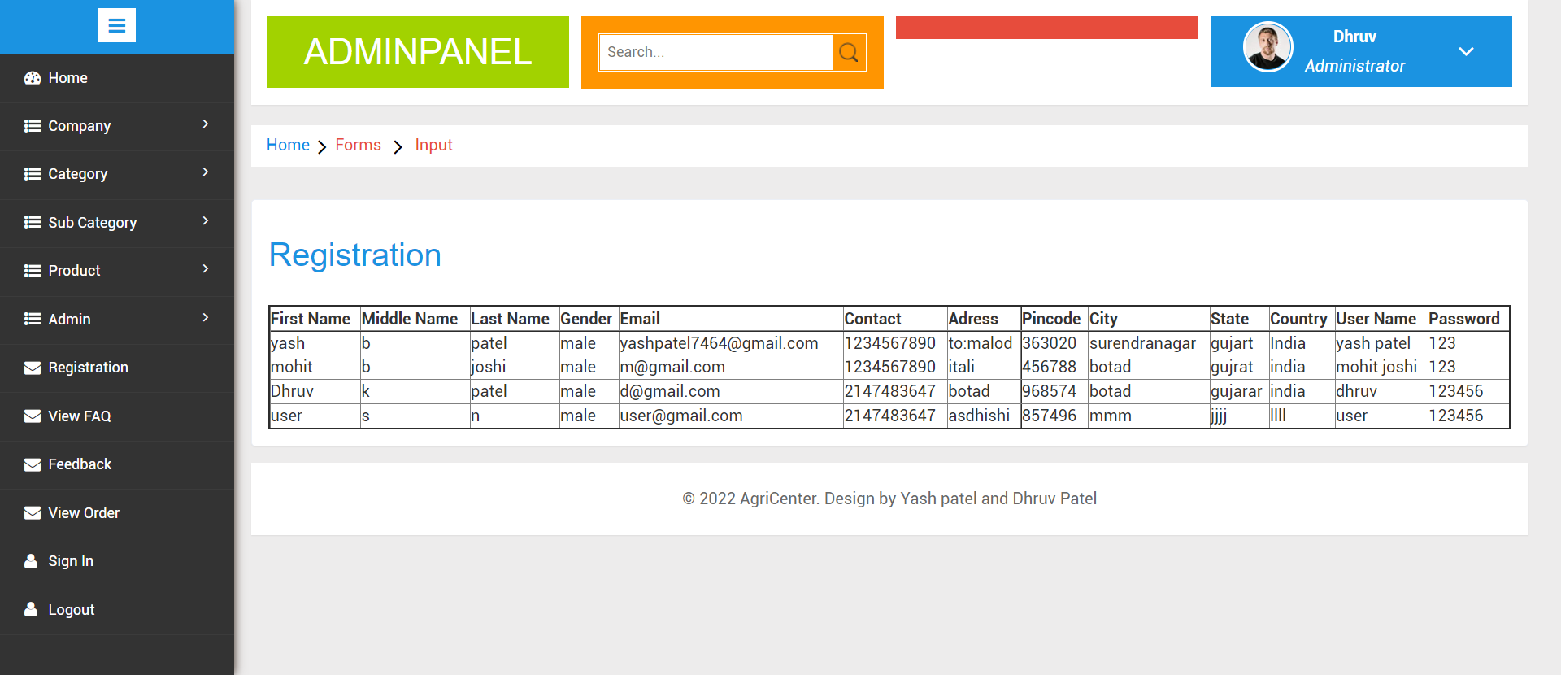
Registration

Slide 42
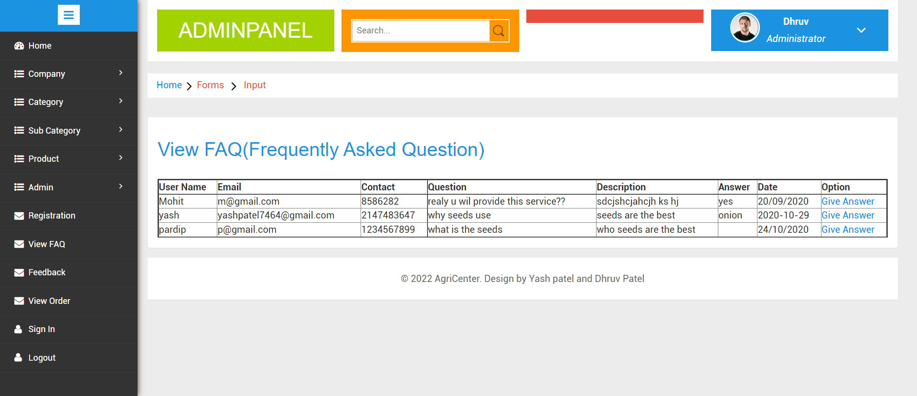
View FAQ

Slide 43
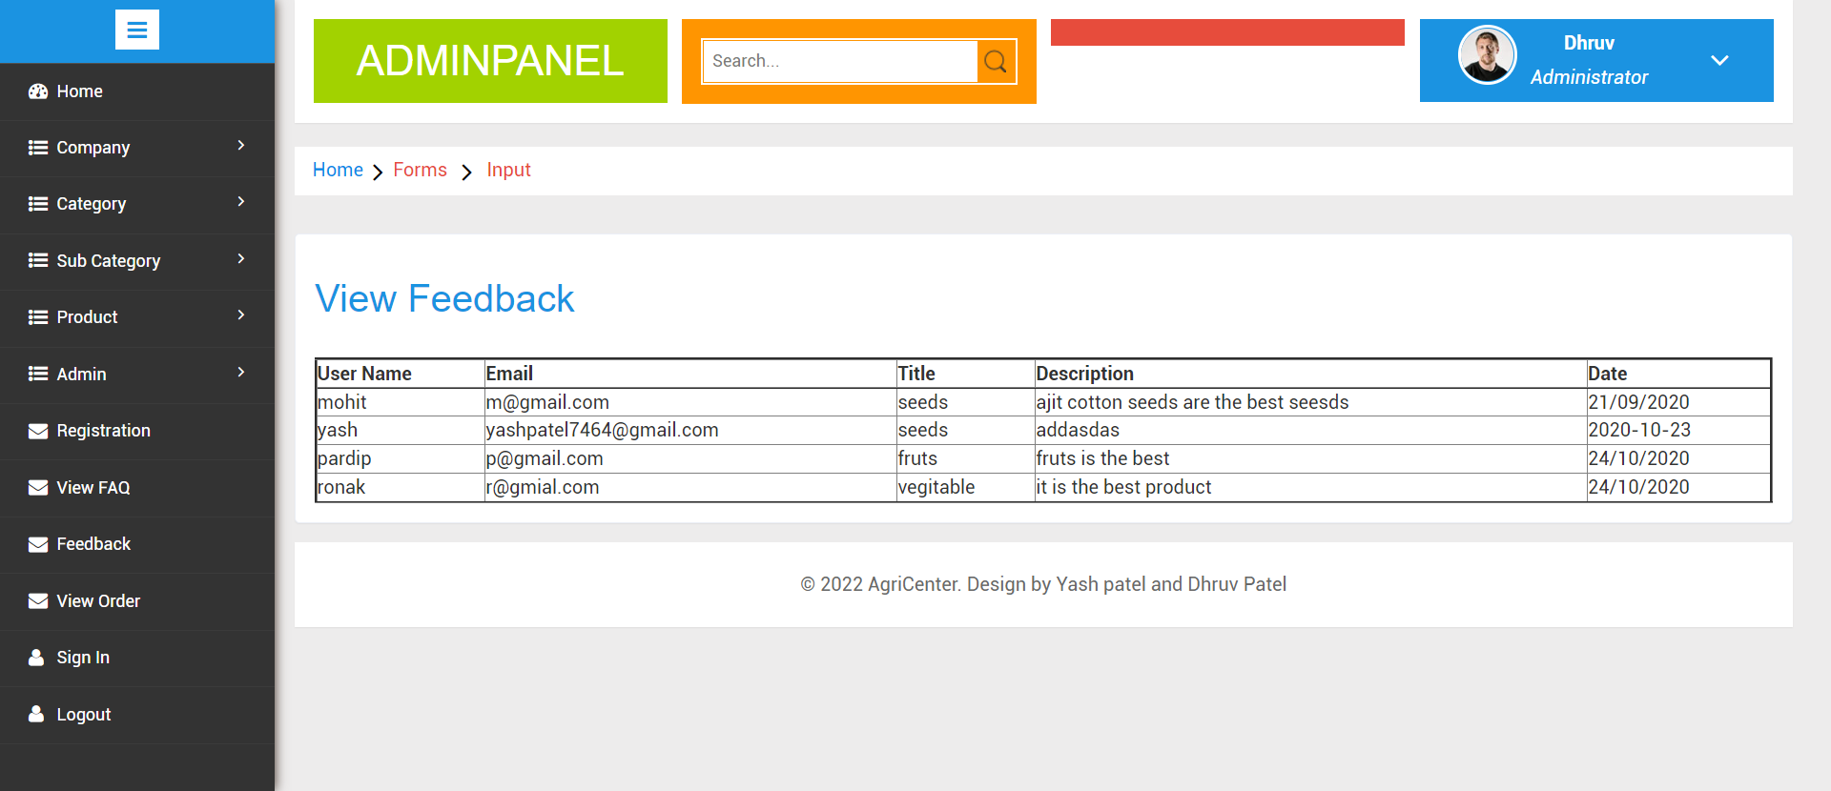
View Feedback

Slide 44
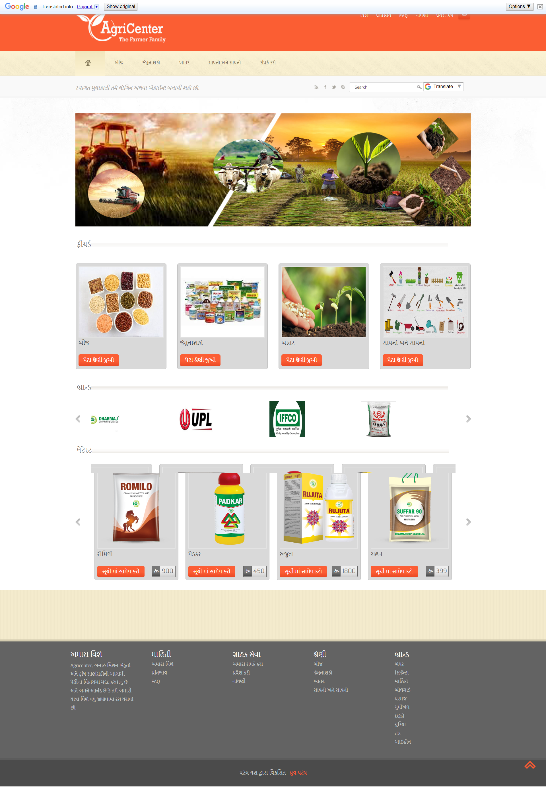
Client Side
Home Page

Slide 45

View Sub Category

Slide 46

View Product

Slide 47

View Product Detail

Slide 48
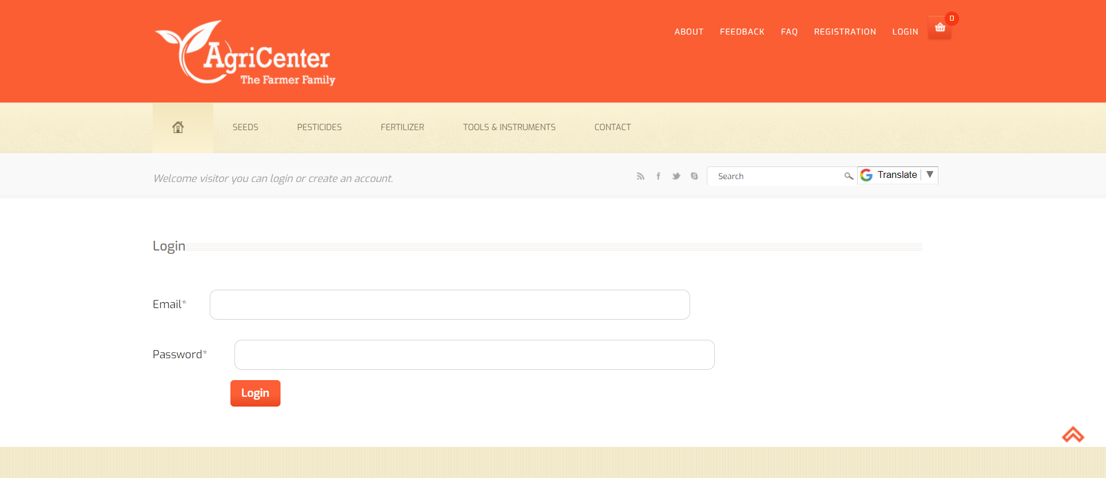
Login

Slide 49
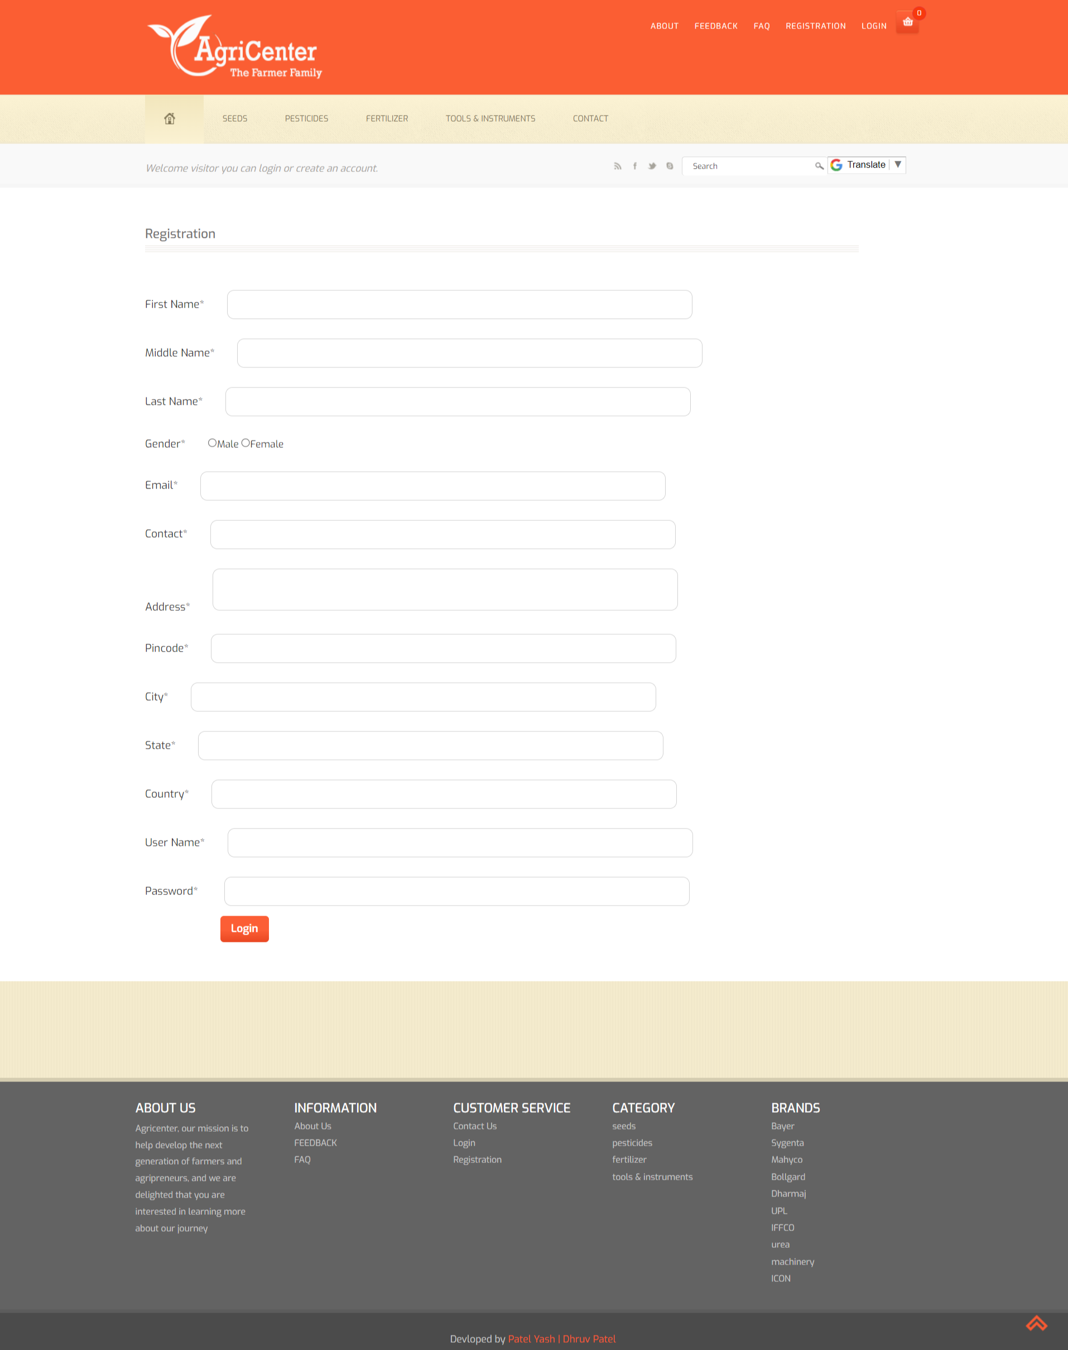
Registration

Slide 50
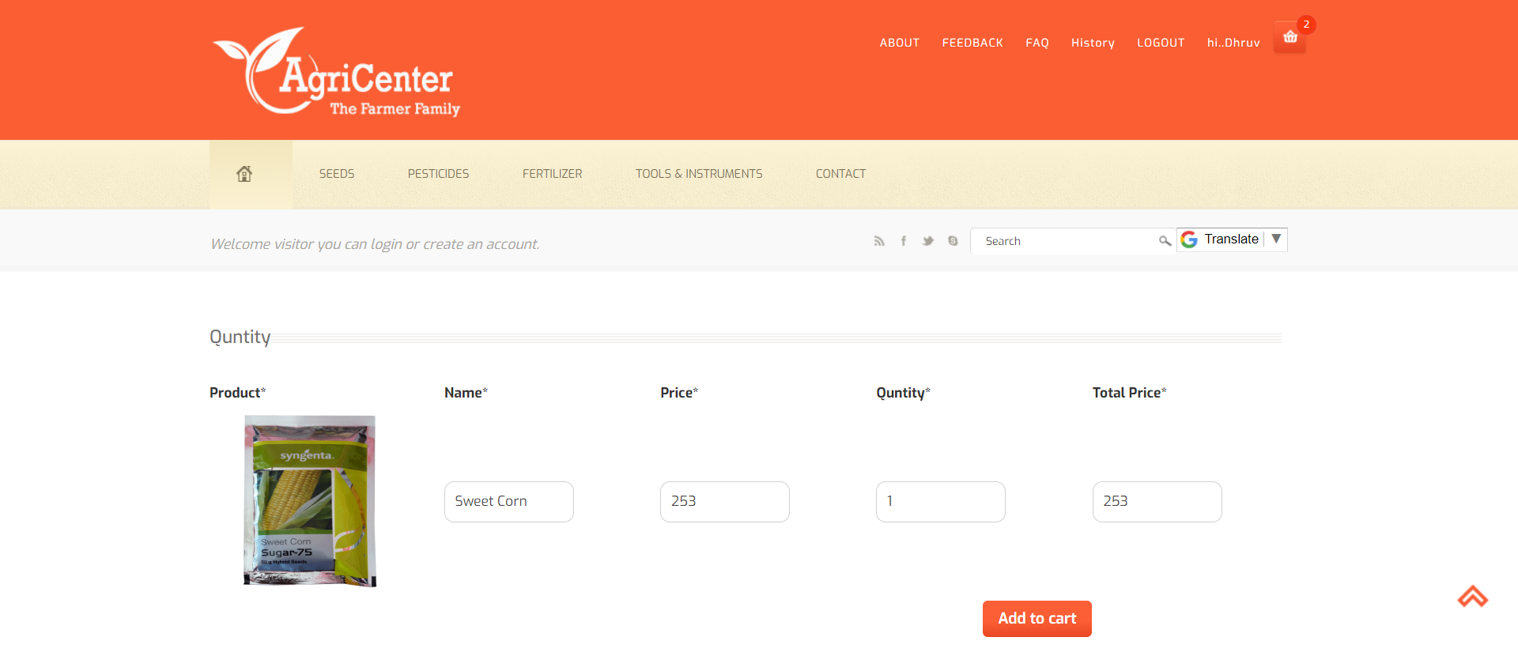
Quantity

Slide 51
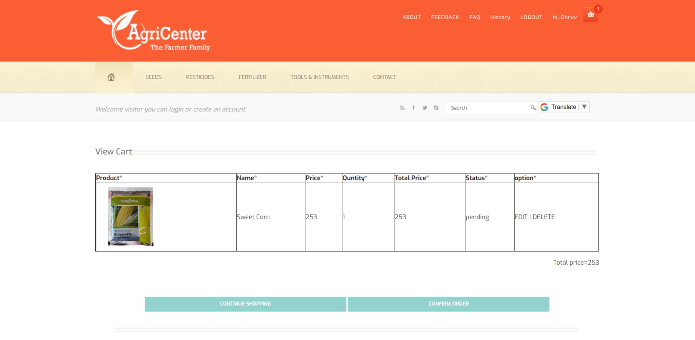
View Cart

Slide 52
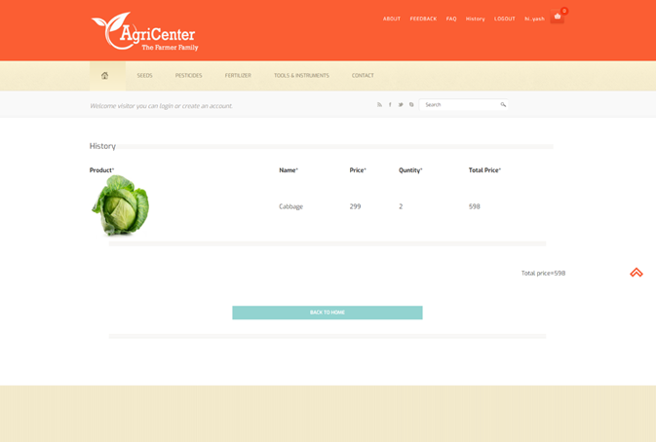
History

Slide 53
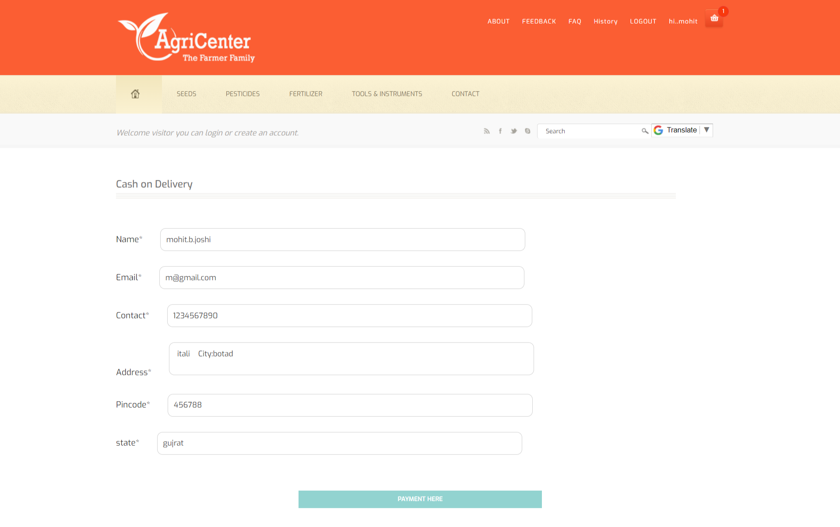
Payment

Slide 54
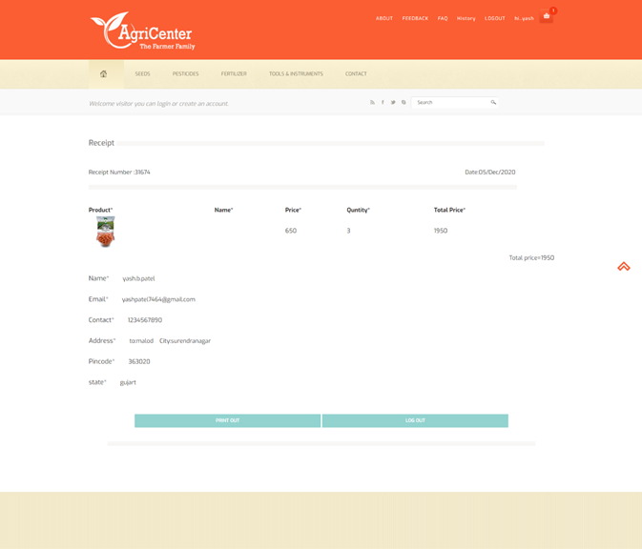
Receipt

Slide 55

About

Slide 56
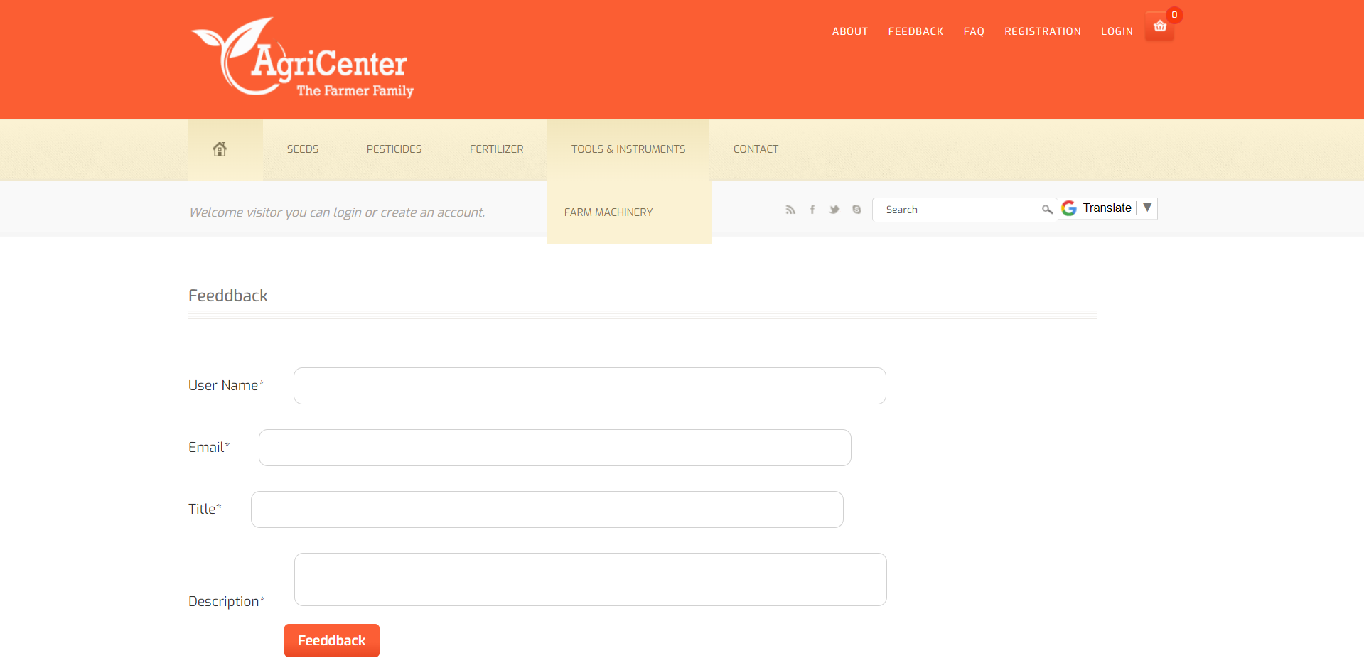
View Feedback

Slide 57
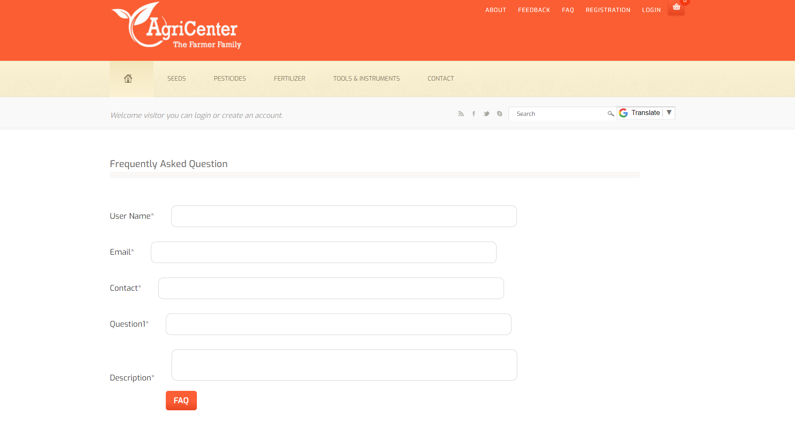
View FAQ

Slide 58
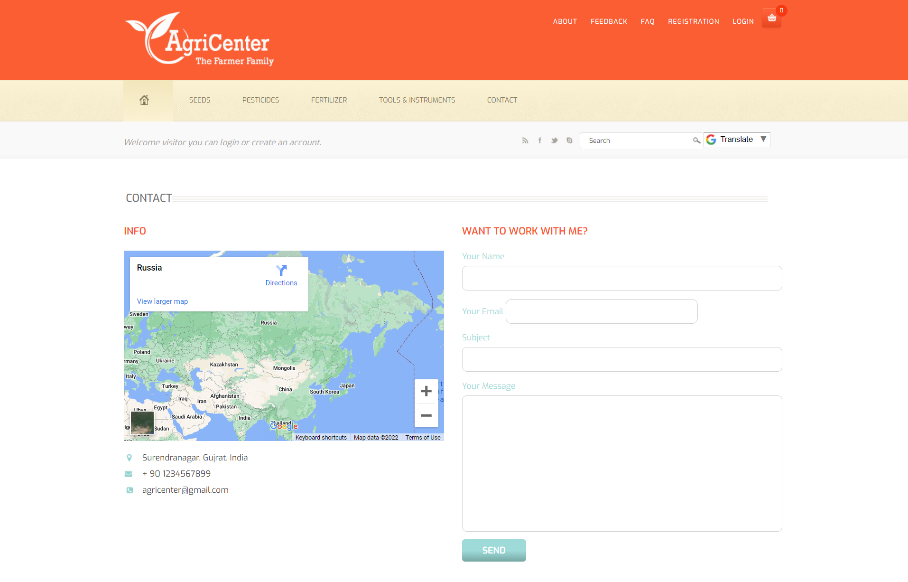
View Contact

Slide 59

Thank You……

